Slide 1
HBD HOUSING LOANS FOR SINGLES G2 – Group 3
Edwin Chong
Elizabeth Lim
Nur Hazlinda
Sneha Murali
Wei Zihao

Slide 2
TABLE OF CONTENTS
01
02
03
04
05
INTRODUCTION
METHODOLOGY
APPROACH
WALKTHROUGH
LIMITATIONS & CONCLUSION

Slide 3
01
INTRODUCTIONS

Slide 4
INTRODUCTION
Business Opportunity Analysis
Business Context
Increase demand for HDB housing loans in Singapore (Yuit, 2022)
Change in demographic with increased number of Singaporeans staying singles (Ho & Ong, 2021)
New government benefits flexibility for Singles applying for HDB housing
To provide housing loans for Singles
Specifically HDB (government property) in Singapore
Target Customers
Single Singaporeans aged 35 – 60
No current property ownership
Notes:
Business opportunity analysis
- Demographic trends -> increasing number of singles delaying marriage & lifestyle
- Govt policies -> new govt schemes helping singles afford housing in sg
- Expensive to buy private properties in Singapore cuz of scarce land
- Research on Housing Loans & benefits of housing loans (from lenders & borrower’s POV)

Slide 5
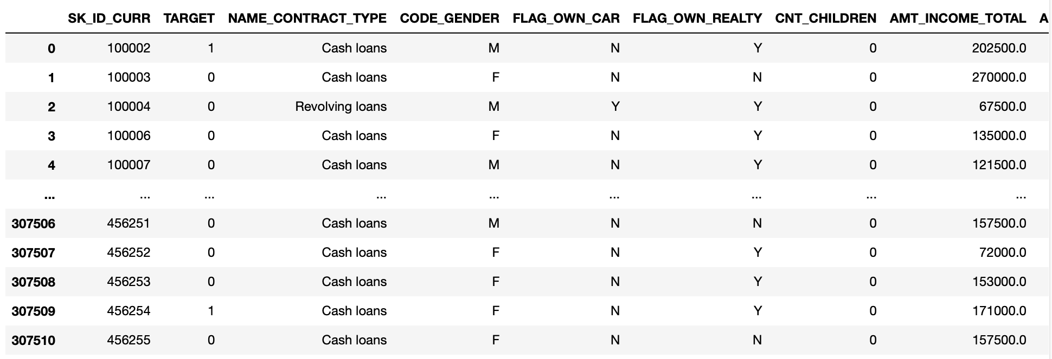
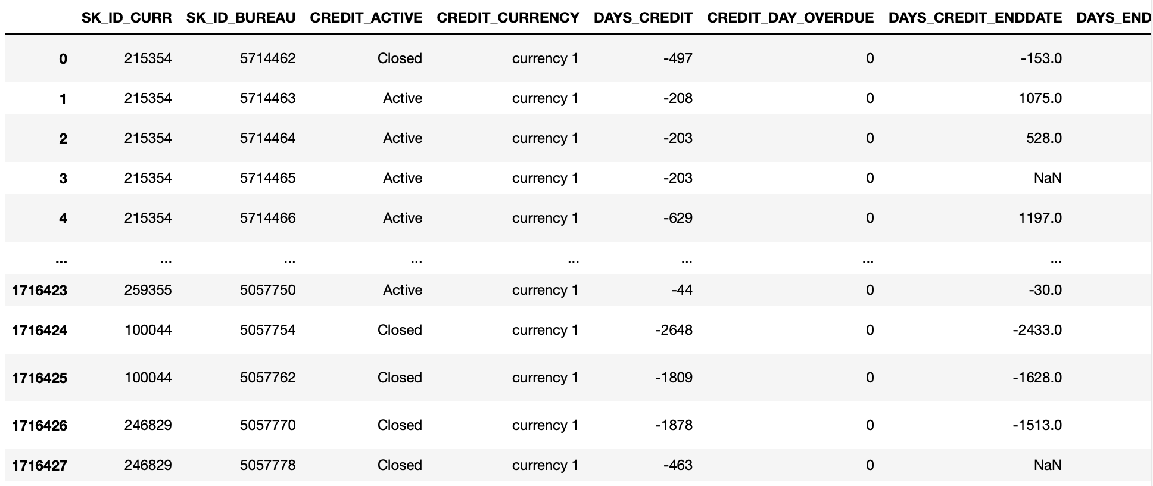
DATASETS VARIABLE INFROMATION
Application Data
Bureau Data
307,511 records
122 columns
1,716,428 records
17 columns
Notes:
app_kept = ['SK_ID_CURR', 'TARGET', 'CODE_GENDER', 'CNT_CHILDREN', 'AMT_INCOME_TOTAL', 'AMT_CREDIT',
'AMT_ANNUITY', 'AMT_GOODS_PRICE', 'REGION_POPULATION_RELATIVE', 'DAYS_REGISTRATION',
'CNT_FAM_MEMBERS', 'ORGANIZATION_TYPE', 'EXT_SOURCE_1', 'EXT_SOURCE_2', 'EXT_SOURCE_3', 'DAYS_BIRTH',
'DAYS_EMPLOYED', 'REG_REGION_NOT_LIVE_REGION', 'REG_REGION_NOT_WORK_REGION',
'LIVE_REGION_NOT_WORK_REGION', 'REG_CITY_NOT_LIVE_CITY', 'REG_CITY_NOT_WORK_CITY',
'LIVE_CITY_NOT_WORK_CITY', 'OCCUPATION_TYPE', 'NAME_EDUCATION_TYPE',
'NAME_INCOME_TYPE', 'REGION_RATING_CLIENT_W_CITY', 'NAME_HOUSING_TYPE','NAME_TYPE_SUITE'
]

Slide 6
02
METHODOLOGIES

Slide 7
PREPROCESSING (VARIABLES IDENTIFIED)
Application Data
SK_ID_CURR (FOR TABLE JOIN)
TARGET
CNT_CHILDREN
AMT_INCOME_TOTAL
AMT_CREDIT
AMT_ANNUITY
AMT_GOODS_PRICE
REGION_POPULATION_RELATIVE
DAYS_REGISTRATION
CNT_FAM_MEMBERS
ORGANIZATION_TYPE
EXT_SOURCE_1
EXT_SOURCE_2
EXT_SOURCE_3
DAYS_BIRTH
DAYS_EMPLOYED
REG_TEGION_NOT_LIVE_REGION
REG_REGION_NOT_WORK_REGION
LIVE_REGION_NOT_WORK_REGION
REG_CITY_NOT_LIVE_CITY
REG_CITY_NOT_WORK_CITY
LIVE_CITY_NOT_WORK_CITY
OCCUPATION_TYPE
NAME_EDUCATION_TYPE
NAME_INCOME_TYPE
REGION_RATING_CLIENT_W_CITY
NAME_HOUSING_TYPE
NAME_TYPE_SUITE
Notes:
app_kept = ['SK_ID_CURR', 'TARGET', 'CODE_GENDER', 'CNT_CHILDREN', 'AMT_INCOME_TOTAL', 'AMT_CREDIT',
'AMT_ANNUITY', 'AMT_GOODS_PRICE', 'REGION_POPULATION_RELATIVE', 'DAYS_REGISTRATION',
'CNT_FAM_MEMBERS', 'ORGANIZATION_TYPE', 'EXT_SOURCE_1', 'EXT_SOURCE_2', 'EXT_SOURCE_3', 'DAYS_BIRTH',
'DAYS_EMPLOYED', 'REG_REGION_NOT_LIVE_REGION’,
'REG_REGION_NOT_WORK_REGION',
'LIVE_REGION_NOT_WORK_REGION', 'REG_CITY_NOT_LIVE_CITY', 'REG_CITY_NOT_WORK_CITY',
'LIVE_CITY_NOT_WORK_CITY', 'OCCUPATION_TYPE', 'NAME_EDUCATION_TYPE',
'NAME_INCOME_TYPE', 'REGION_RATING_CLIENT_W_CITY', 'NAME_HOUSING_TYPE','NAME_TYPE_SUITE'
]

Slide 8
PREPROCESSING (DATA TRANSFORMATION)
Application Data
Set data to only SINGLES that don’t own real estate
df_app = df_app[(df_app['NAME_FAMILY_STATUS'] == 'Single / not married') & (df_app['FLAG_OWN_REALTY'] == 'N')]
Adjust DAYS related variables to MONTHS & remove Negatives
df_app_kept['AGE'] = -df_app_kept['DAYS_BIRTH']/365
df_app_kept['MONTHS_EMPLOYED'] = -df_app_kept['DAYS_EMPLOYED']/30
df_app_kept['MONTHS_REGISTRATION'] = -df_app_kept['DAYS_REGISTRATION']/30
Remove old DAYS related variables
df_app_kept.drop(['DAYS_BIRTH', 'DAYS_EMPLOYED', 'DAYS_REGISTRATION'], axis = 1, inplace=True)
Restrict Age to 35-60
df_app_kept = df_app_kept[(df_app_kept['AGE'] >= 35) & (df_app_kept['AGE'] < 60)]
Notes:
# reduce data set to only singles that do not own real estate (exclude singles who currently own real estate)
df_app = df_app[(df_app['NAME_FAMILY_STATUS'] == 'Single / not married') & (df_app['FLAG_OWN_REALTY'] == 'N')]
df_app.head()
# adjust DAYS_% variables to MONTHS and remove negative
df_app_kept['AGE'] = -df_app_kept['DAYS_BIRTH']/365
df_app_kept['MONTHS_EMPLOYED'] = -df_app_kept['DAYS_EMPLOYED']/30
df_app_kept['MONTHS_REGISTRATION'] = -df_app_kept['DAYS_REGISTRATION']/30
df_app_kept.drop(['DAYS_BIRTH', 'DAYS_EMPLOYED', 'DAYS_REGISTRATION'], axis = 1, inplace=True)
# resetrict age to 35 - 60
df_app_kept = df_app_kept[(df_app_kept['AGE'] >= 35) & (df_app_kept['AGE'] < 60)]
df_app_kept.shape

Slide 9
PREPROCESSING (DATA TRANSFORMATION)
Bureau Data
Group together credit lines for each unique applicant (SK_ID_CURR)
Transform Variables
SUM together below variables for all credit lines per applicant
AMT_CREDIT_SUM_OVERDUE,
AMT_CREDIT_SUM_DEBT
AMT_ANNUITY
Average of CNT_CREDIT_PROLONG
Final Variables
SK_ID_CURR (FOR TABLE JOIN)
SUM_AMT_CREDIT_SUM_OVERDUE
SUM_AMT_CREDIT_SUM_DEBT
AVG_CNT_CREDIT_PROLONG
SUM_AMT_ANNUITY
Notes:
# reduce data set to only singles that do not own real estate (exclude singles who currently own real estate)
df_app = df_app[(df_app['NAME_FAMILY_STATUS'] == 'Single / not married') & (df_app['FLAG_OWN_REALTY'] == 'N')]
df_app.head()
# adjust DAYS_% variables to MONTHS and remove negative
df_app_kept['AGE'] = -df_app_kept['DAYS_BIRTH']/365
df_app_kept['MONTHS_EMPLOYED'] = -df_app_kept['DAYS_EMPLOYED']/30
df_app_kept['MONTHS_REGISTRATION'] = -df_app_kept['DAYS_REGISTRATION']/30
df_app_kept.drop(['DAYS_BIRTH', 'DAYS_EMPLOYED', 'DAYS_REGISTRATION'], axis = 1, inplace=True)
# resetrict age to 35 - 60
df_app_kept = df_app_kept[(df_app_kept['AGE'] >= 35) & (df_app_kept['AGE'] < 60)]
df_app_kept.shape

Slide 10
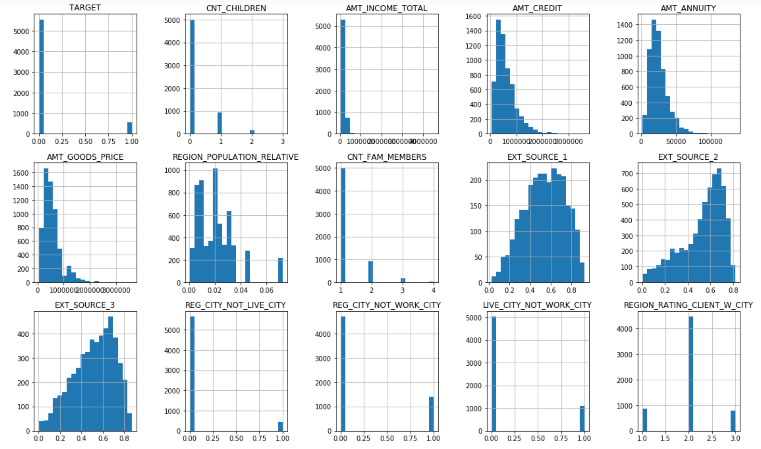
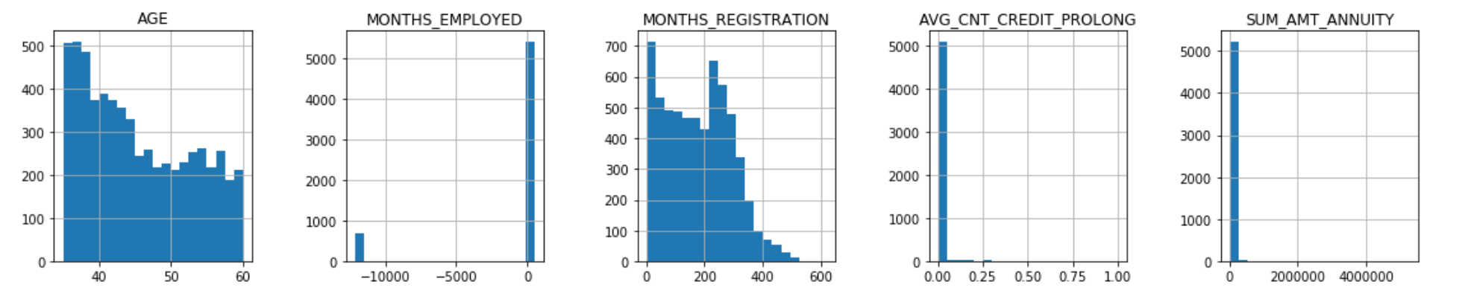
EXPLORATIVE DATA ANALYSIS (UNIVARIATE ANALYSIS)
Histograms
Numerical Variables
To understand distribution of variables
Notes:
# bureau data modification / engineering
bur_kept = ['SK_ID_CURR', 'CREDIT_ACTIVE','AMT_CREDIT_SUM', 'AMT_CREDIT_SUM_OVERDUE', 'AMT_CREDIT_SUM_DEBT', 'CNT_CREDIT_PROLONG', 'AMT_ANNUITY',
]
df_bur_kept = df_bur[bur_kept]
df_bur_kept.head()
# Create a new df_bur_modified
df_bur_modified = pd.DataFrame()
# Add SK_ID_CURR to facilitate joins
df_bur_modified['SK_ID_CURR'] = df_bur_kept['SK_ID_CURR'].unique()
# Join groupby table for the average of CNT_CREDIT_PROLONG
df_bur_modified = df_bur_modified.merge(
pd.DataFrame(df_bur_kept.groupby('SK_ID_CURR')['CNT_CREDIT_PROLONG'].mean()),
on='SK_ID_CURR', how='left')
# Join groupby table for the sum of AMT_ANNUITY
df_bur_modified = df_bur_modified.merge(
pd.DataFrame(df_bur_kept.groupby('SK_ID_CURR')['AMT_ANNUITY'].sum()),
on='SK_ID_CURR', how='left')
# Join groupby table for the sum of AMT_CREDIT_SUM_OVERDUE
df_bur_modified = df_bur_modified.merge(
pd.DataFrame(df_bur_kept.groupby('SK_ID_CURR')['AMT_CREDIT_SUM_OVERDUE'].sum()),
on='SK_ID_CURR', how='left')
# Join groupby table for the sum of AMT_CREDIT_SUM_DEBT
df_bur_modified = df_bur_modified.merge(
pd.DataFrame(df_bur_kept.groupby('SK_ID_CURR')['AMT_CREDIT_SUM_DEBT'].sum()),
on='SK_ID_CURR', how='left')
# Join groupby table for the most frequent credit type and rename the column
# df_bur_modified = df_bur_modified.merge(
# pd.DataFrame(df_bur_kept.groupby('SK_ID_CURR')['CREDIT_TYPE'].agg(lambda x: x.value_counts().idxmax())),
# on='SK_ID_CURR', how='left')
df_bur_modified.columns = [
'SK_ID_CURR', 'AVG_CNT_CREDIT_PROLONG', 'SUM_AMT_ANNUITY',
'SUM_AMT_CREDIT_SUM_OVERDUE', 'SUM_AMT_CREDIT_SUM_DEBT',
# 'MOST_FREQUENT_CREDIT_TYPE'
]
df_bur_modified
# join bureau data on main
df = df_app_kept.merge(df_bur_modified, on = 'SK_ID_CURR', how = 'left')
df.drop('SK_ID_CURR', axis=1, inplace=True)
df

Slide 11
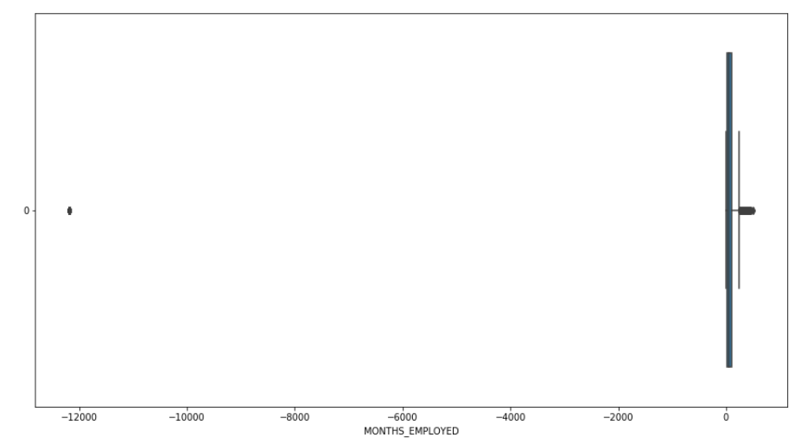
EXPLORATIVE DATA ANALYSIS (UNIVARIATE ANALYSIS)
Boxplot
Continuous Variables
To identify outliers
Invalid Observations Identified
MONTHS_EMPLOYED < -12,000
Translates to >1,000 years of being employed
Notes:
# bureau data modification / engineering
bur_kept = ['SK_ID_CURR', 'CREDIT_ACTIVE','AMT_CREDIT_SUM', 'AMT_CREDIT_SUM_OVERDUE', 'AMT_CREDIT_SUM_DEBT', 'CNT_CREDIT_PROLONG', 'AMT_ANNUITY',
]
df_bur_kept = df_bur[bur_kept]
df_bur_kept.head()
# Create a new df_bur_modified
df_bur_modified = pd.DataFrame()
# Add SK_ID_CURR to facilitate joins
df_bur_modified['SK_ID_CURR'] = df_bur_kept['SK_ID_CURR'].unique()
# Join groupby table for the average of CNT_CREDIT_PROLONG
df_bur_modified = df_bur_modified.merge(
pd.DataFrame(df_bur_kept.groupby('SK_ID_CURR')['CNT_CREDIT_PROLONG'].mean()),
on='SK_ID_CURR', how='left')
# Join groupby table for the sum of AMT_ANNUITY
df_bur_modified = df_bur_modified.merge(
pd.DataFrame(df_bur_kept.groupby('SK_ID_CURR')['AMT_ANNUITY'].sum()),
on='SK_ID_CURR', how='left')
# Join groupby table for the sum of AMT_CREDIT_SUM_OVERDUE
df_bur_modified = df_bur_modified.merge(
pd.DataFrame(df_bur_kept.groupby('SK_ID_CURR')['AMT_CREDIT_SUM_OVERDUE'].sum()),
on='SK_ID_CURR', how='left')
# Join groupby table for the sum of AMT_CREDIT_SUM_DEBT
df_bur_modified = df_bur_modified.merge(
pd.DataFrame(df_bur_kept.groupby('SK_ID_CURR')['AMT_CREDIT_SUM_DEBT'].sum()),
on='SK_ID_CURR', how='left')
# Join groupby table for the most frequent credit type and rename the column
# df_bur_modified = df_bur_modified.merge(
# pd.DataFrame(df_bur_kept.groupby('SK_ID_CURR')['CREDIT_TYPE'].agg(lambda x: x.value_counts().idxmax())),
# on='SK_ID_CURR', how='left')
df_bur_modified.columns = [
'SK_ID_CURR', 'AVG_CNT_CREDIT_PROLONG', 'SUM_AMT_ANNUITY',
'SUM_AMT_CREDIT_SUM_OVERDUE', 'SUM_AMT_CREDIT_SUM_DEBT',
# 'MOST_FREQUENT_CREDIT_TYPE'
]
df_bur_modified
# join bureau data on main
df = df_app_kept.merge(df_bur_modified, on = 'SK_ID_CURR', how = 'left')
df.drop('SK_ID_CURR', axis=1, inplace=True)
df

Slide 12
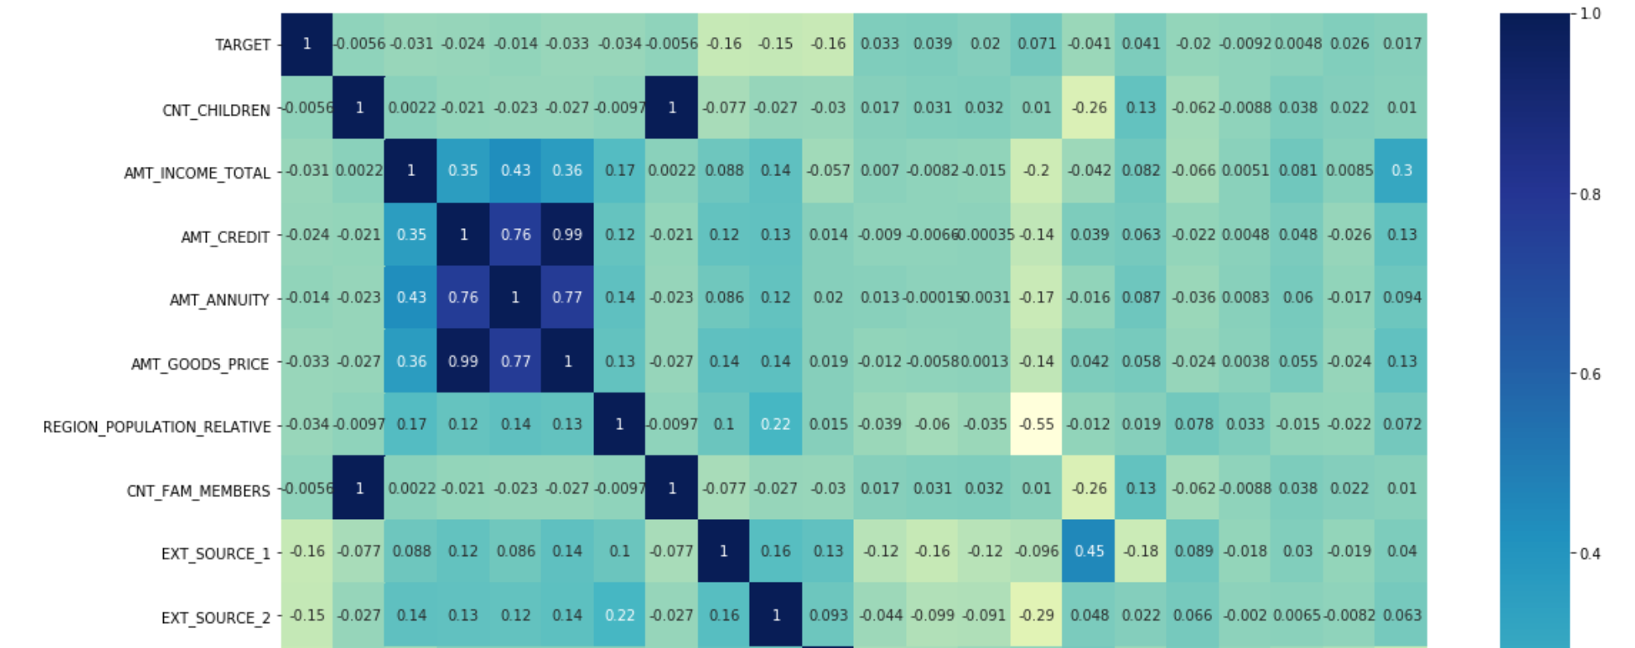
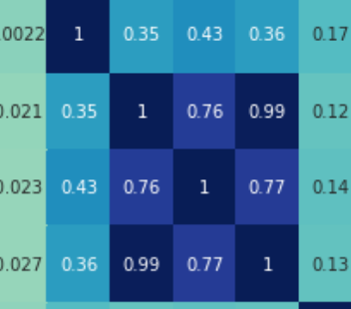
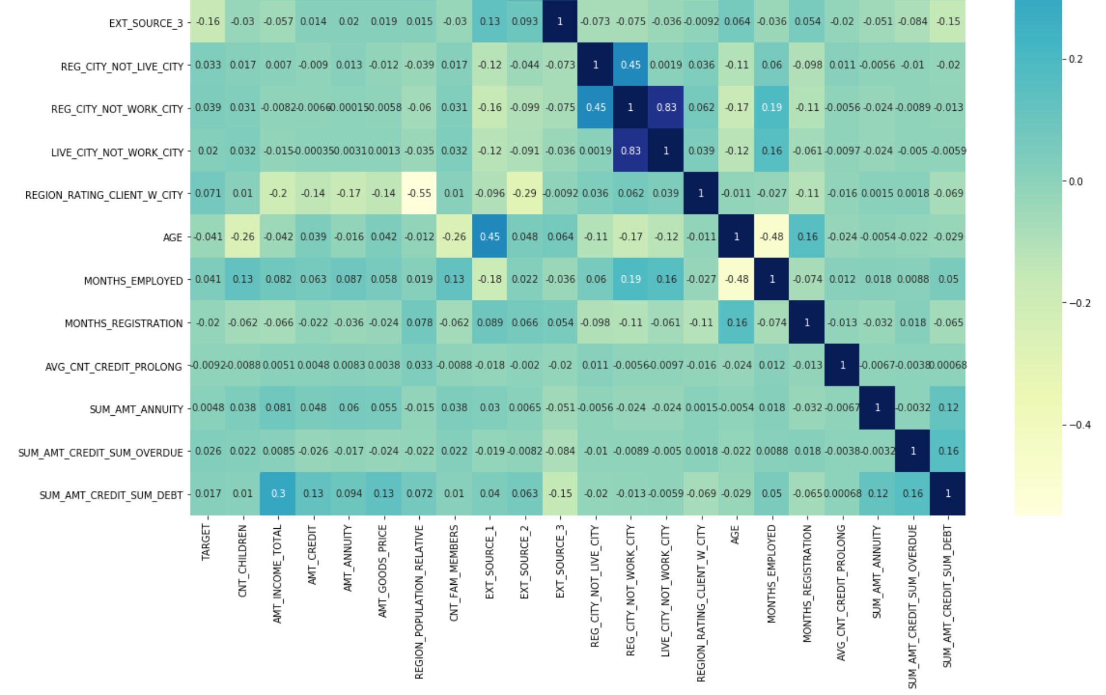
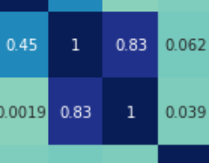
EXPLORATIVE DATA ANALYSIS (UNIVARIATE ANALYSIS)
Correlation Heat Map
Numerical variables
Identify Variables that are Highly Correlated
Correlated Variables
AMT_CREDIT & AMT_GOODS_PRICE = 0.99
REG_CITY_NOT_WORK_CITY & LIVE_CITY_NOT_WORK_CITY = 0.83
AMT_ANNUITY & AMT_GOODS_PRICE = 0.77
AMT_CREDIT & AMT_ANNUITY = 0.76
Notes:
# bureau data modification / engineering
bur_kept = ['SK_ID_CURR', 'CREDIT_ACTIVE','AMT_CREDIT_SUM', 'AMT_CREDIT_SUM_OVERDUE', 'AMT_CREDIT_SUM_DEBT', 'CNT_CREDIT_PROLONG', 'AMT_ANNUITY',
]
df_bur_kept = df_bur[bur_kept]
df_bur_kept.head()
# Create a new df_bur_modified
df_bur_modified = pd.DataFrame()
# Add SK_ID_CURR to facilitate joins
df_bur_modified['SK_ID_CURR'] = df_bur_kept['SK_ID_CURR'].unique()
# Join groupby table for the average of CNT_CREDIT_PROLONG
df_bur_modified = df_bur_modified.merge(
pd.DataFrame(df_bur_kept.groupby('SK_ID_CURR')['CNT_CREDIT_PROLONG'].mean()),
on='SK_ID_CURR', how='left')
# Join groupby table for the sum of AMT_ANNUITY
df_bur_modified = df_bur_modified.merge(
pd.DataFrame(df_bur_kept.groupby('SK_ID_CURR')['AMT_ANNUITY'].sum()),
on='SK_ID_CURR', how='left')
# Join groupby table for the sum of AMT_CREDIT_SUM_OVERDUE
df_bur_modified = df_bur_modified.merge(
pd.DataFrame(df_bur_kept.groupby('SK_ID_CURR')['AMT_CREDIT_SUM_OVERDUE'].sum()),
on='SK_ID_CURR', how='left')
# Join groupby table for the sum of AMT_CREDIT_SUM_DEBT
df_bur_modified = df_bur_modified.merge(
pd.DataFrame(df_bur_kept.groupby('SK_ID_CURR')['AMT_CREDIT_SUM_DEBT'].sum()),
on='SK_ID_CURR', how='left')
# Join groupby table for the most frequent credit type and rename the column
# df_bur_modified = df_bur_modified.merge(
# pd.DataFrame(df_bur_kept.groupby('SK_ID_CURR')['CREDIT_TYPE'].agg(lambda x: x.value_counts().idxmax())),
# on='SK_ID_CURR', how='left')
df_bur_modified.columns = [
'SK_ID_CURR', 'AVG_CNT_CREDIT_PROLONG', 'SUM_AMT_ANNUITY',
'SUM_AMT_CREDIT_SUM_OVERDUE', 'SUM_AMT_CREDIT_SUM_DEBT',
# 'MOST_FREQUENT_CREDIT_TYPE'
]
df_bur_modified
# join bureau data on main
df = df_app_kept.merge(df_bur_modified, on = 'SK_ID_CURR', how = 'left')
df.drop('SK_ID_CURR', axis=1, inplace=True)
df

Slide 13
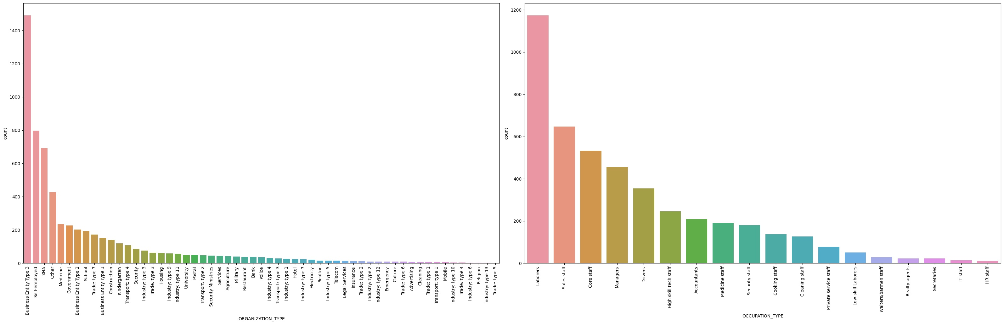
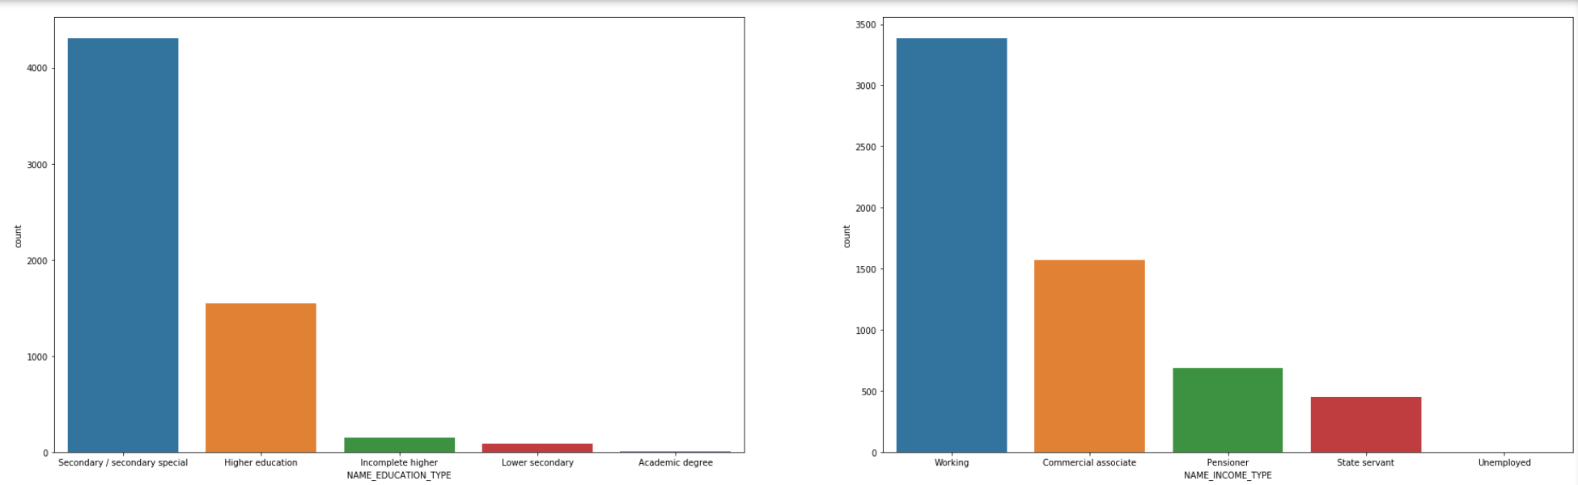
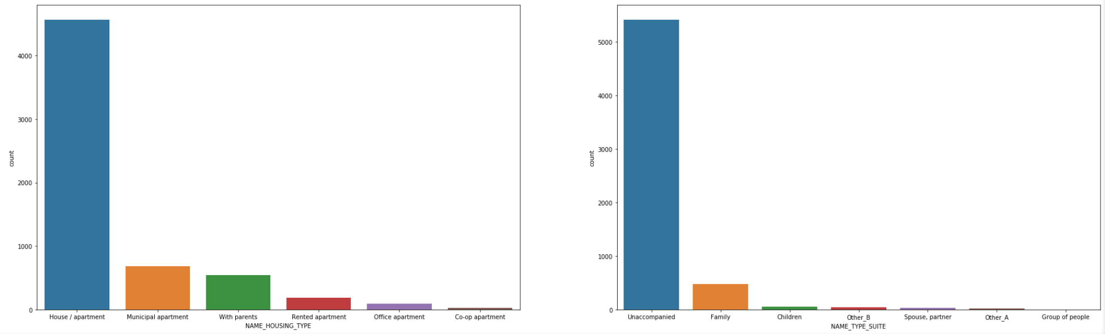
EXPLORATIVE DATA ANALYSIS (UNIVARIATE ANALYSIS)
Bar Charts
Categorical Variables
To understand distribution of variables
Notes:
# bureau data modification / engineering
bur_kept = ['SK_ID_CURR', 'CREDIT_ACTIVE','AMT_CREDIT_SUM', 'AMT_CREDIT_SUM_OVERDUE', 'AMT_CREDIT_SUM_DEBT', 'CNT_CREDIT_PROLONG', 'AMT_ANNUITY',
]
df_bur_kept = df_bur[bur_kept]
df_bur_kept.head()
# Create a new df_bur_modified
df_bur_modified = pd.DataFrame()
# Add SK_ID_CURR to facilitate joins
df_bur_modified['SK_ID_CURR'] = df_bur_kept['SK_ID_CURR'].unique()
# Join groupby table for the average of CNT_CREDIT_PROLONG
df_bur_modified = df_bur_modified.merge(
pd.DataFrame(df_bur_kept.groupby('SK_ID_CURR')['CNT_CREDIT_PROLONG'].mean()),
on='SK_ID_CURR', how='left')
# Join groupby table for the sum of AMT_ANNUITY
df_bur_modified = df_bur_modified.merge(
pd.DataFrame(df_bur_kept.groupby('SK_ID_CURR')['AMT_ANNUITY'].sum()),
on='SK_ID_CURR', how='left')
# Join groupby table for the sum of AMT_CREDIT_SUM_OVERDUE
df_bur_modified = df_bur_modified.merge(
pd.DataFrame(df_bur_kept.groupby('SK_ID_CURR')['AMT_CREDIT_SUM_OVERDUE'].sum()),
on='SK_ID_CURR', how='left')
# Join groupby table for the sum of AMT_CREDIT_SUM_DEBT
df_bur_modified = df_bur_modified.merge(
pd.DataFrame(df_bur_kept.groupby('SK_ID_CURR')['AMT_CREDIT_SUM_DEBT'].sum()),
on='SK_ID_CURR', how='left')
# Join groupby table for the most frequent credit type and rename the column
# df_bur_modified = df_bur_modified.merge(
# pd.DataFrame(df_bur_kept.groupby('SK_ID_CURR')['CREDIT_TYPE'].agg(lambda x: x.value_counts().idxmax())),
# on='SK_ID_CURR', how='left')
df_bur_modified.columns = [
'SK_ID_CURR', 'AVG_CNT_CREDIT_PROLONG', 'SUM_AMT_ANNUITY',
'SUM_AMT_CREDIT_SUM_OVERDUE', 'SUM_AMT_CREDIT_SUM_DEBT',
# 'MOST_FREQUENT_CREDIT_TYPE'
]
df_bur_modified
# join bureau data on main
df = df_app_kept.merge(df_bur_modified, on = 'SK_ID_CURR', how = 'left')
df.drop('SK_ID_CURR', axis=1, inplace=True)
df

Slide 14
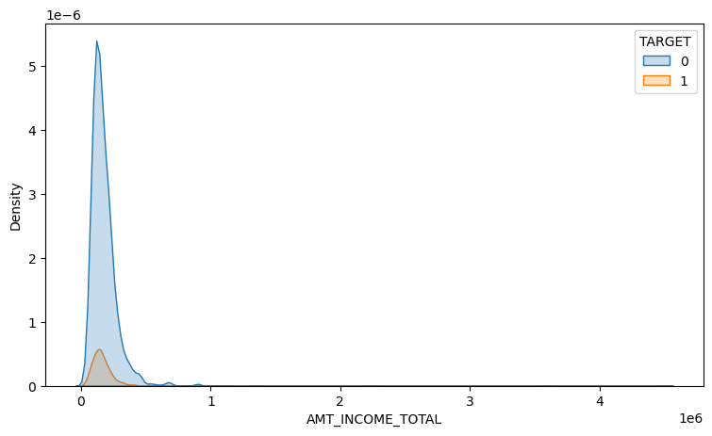
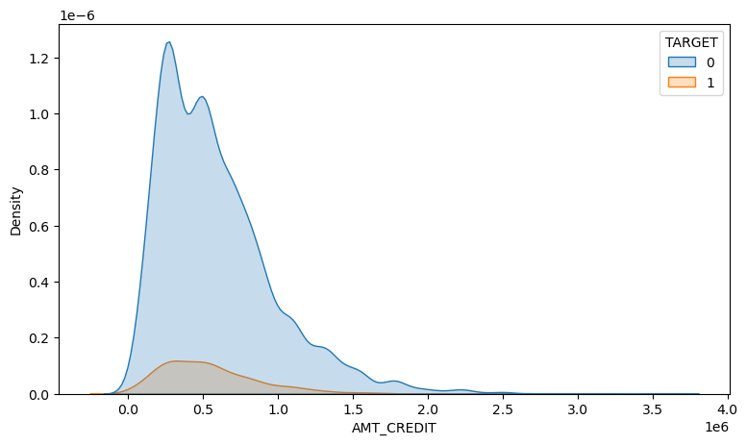
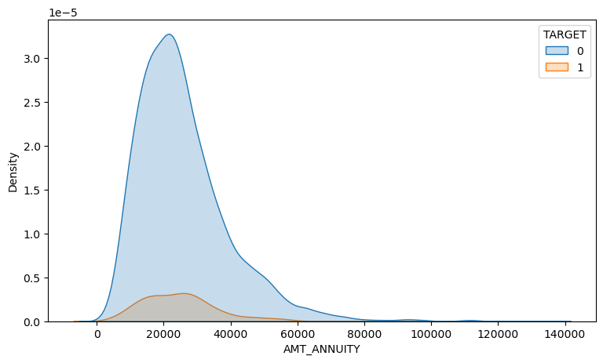
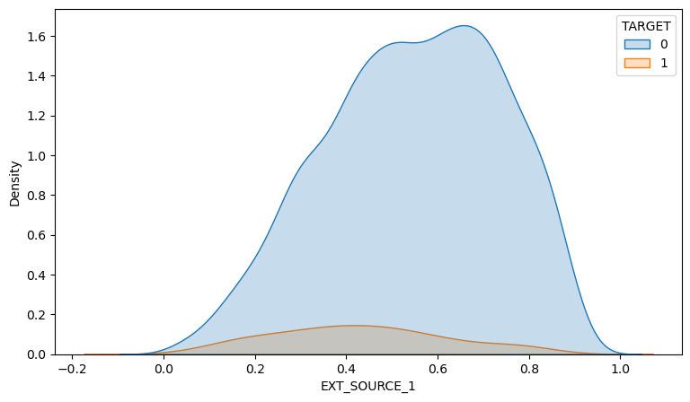
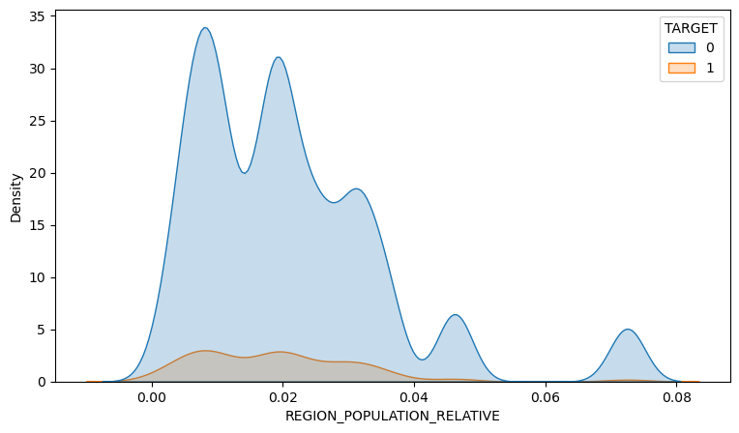
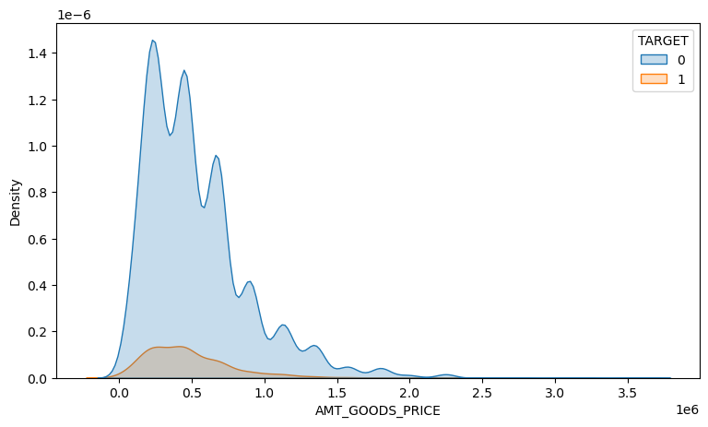
EXPLORATIVE DATA ANALYSIS (BIVARIATE ANALYSIS)
KDE PLOTS
Numerical Variables
To understand distribution of events & non-events
Notes:
# bureau data modification / engineering
bur_kept = ['SK_ID_CURR', 'CREDIT_ACTIVE','AMT_CREDIT_SUM', 'AMT_CREDIT_SUM_OVERDUE', 'AMT_CREDIT_SUM_DEBT', 'CNT_CREDIT_PROLONG', 'AMT_ANNUITY',
]
df_bur_kept = df_bur[bur_kept]
df_bur_kept.head()
# Create a new df_bur_modified
df_bur_modified = pd.DataFrame()
# Add SK_ID_CURR to facilitate joins
df_bur_modified['SK_ID_CURR'] = df_bur_kept['SK_ID_CURR'].unique()
# Join groupby table for the average of CNT_CREDIT_PROLONG
df_bur_modified = df_bur_modified.merge(
pd.DataFrame(df_bur_kept.groupby('SK_ID_CURR')['CNT_CREDIT_PROLONG'].mean()),
on='SK_ID_CURR', how='left')
# Join groupby table for the sum of AMT_ANNUITY
df_bur_modified = df_bur_modified.merge(
pd.DataFrame(df_bur_kept.groupby('SK_ID_CURR')['AMT_ANNUITY'].sum()),
on='SK_ID_CURR', how='left')
# Join groupby table for the sum of AMT_CREDIT_SUM_OVERDUE
df_bur_modified = df_bur_modified.merge(
pd.DataFrame(df_bur_kept.groupby('SK_ID_CURR')['AMT_CREDIT_SUM_OVERDUE'].sum()),
on='SK_ID_CURR', how='left')
# Join groupby table for the sum of AMT_CREDIT_SUM_DEBT
df_bur_modified = df_bur_modified.merge(
pd.DataFrame(df_bur_kept.groupby('SK_ID_CURR')['AMT_CREDIT_SUM_DEBT'].sum()),
on='SK_ID_CURR', how='left')
# Join groupby table for the most frequent credit type and rename the column
# df_bur_modified = df_bur_modified.merge(
# pd.DataFrame(df_bur_kept.groupby('SK_ID_CURR')['CREDIT_TYPE'].agg(lambda x: x.value_counts().idxmax())),
# on='SK_ID_CURR', how='left')
df_bur_modified.columns = [
'SK_ID_CURR', 'AVG_CNT_CREDIT_PROLONG', 'SUM_AMT_ANNUITY',
'SUM_AMT_CREDIT_SUM_OVERDUE', 'SUM_AMT_CREDIT_SUM_DEBT',
# 'MOST_FREQUENT_CREDIT_TYPE'
]
df_bur_modified
# join bureau data on main
df = df_app_kept.merge(df_bur_modified, on = 'SK_ID_CURR', how = 'left')
df.drop('SK_ID_CURR', axis=1, inplace=True)
df

Slide 15
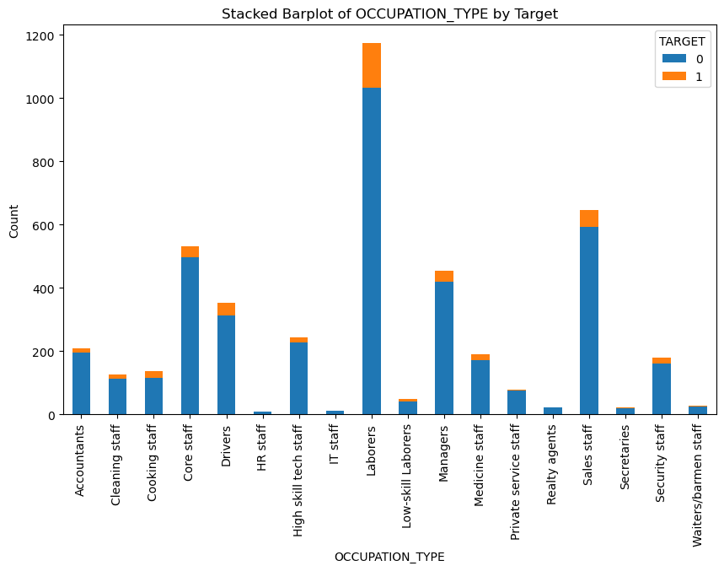
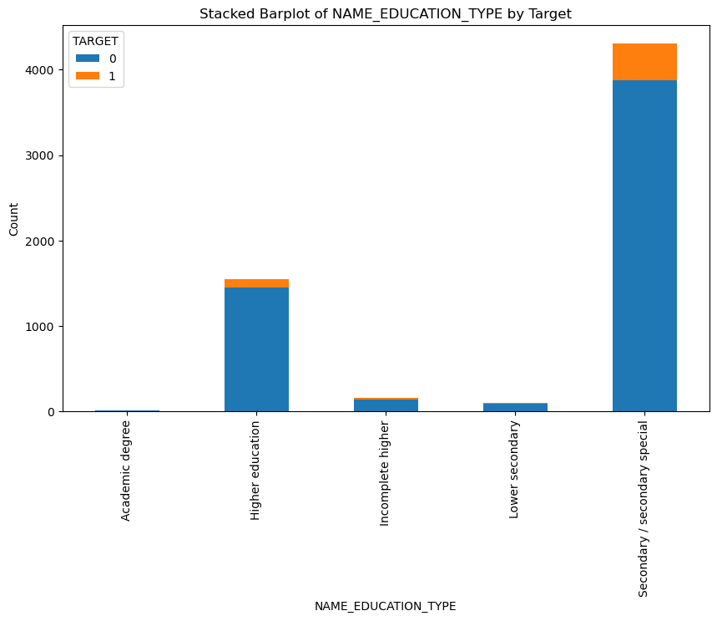
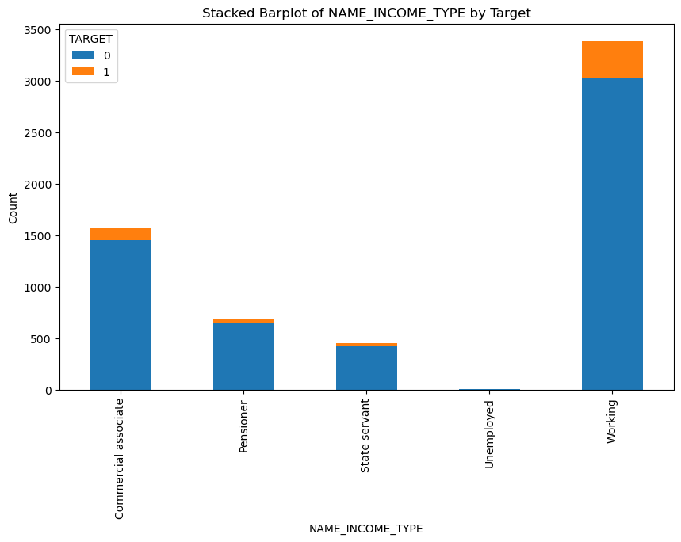
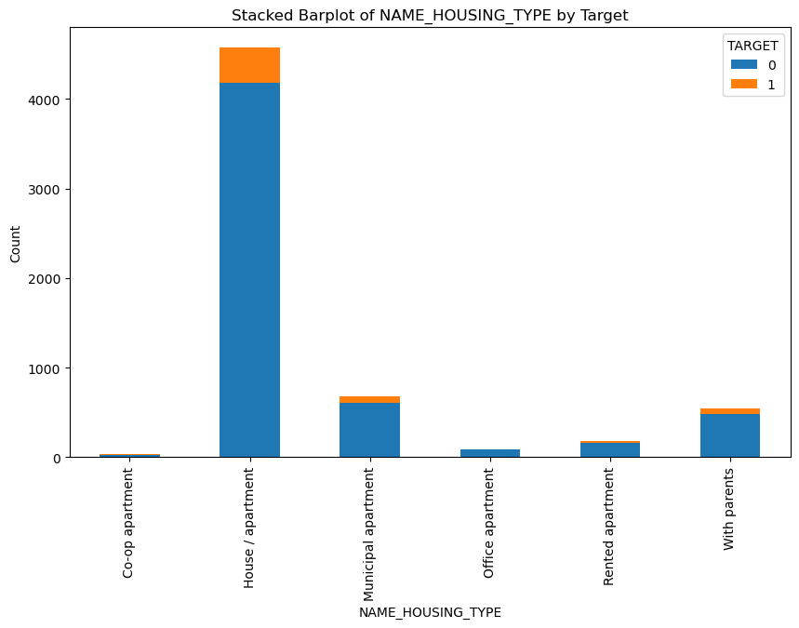
EXPLORATIVE DATA ANALYSIS (UNIVARIATE ANALYSIS)
Stacked Bar Charts
Categorical Variables
To understand distribution of events & non-events
Notes:
# bureau data modification / engineering
bur_kept = ['SK_ID_CURR', 'CREDIT_ACTIVE','AMT_CREDIT_SUM', 'AMT_CREDIT_SUM_OVERDUE', 'AMT_CREDIT_SUM_DEBT', 'CNT_CREDIT_PROLONG', 'AMT_ANNUITY',
]
df_bur_kept = df_bur[bur_kept]
df_bur_kept.head()
# Create a new df_bur_modified
df_bur_modified = pd.DataFrame()
# Add SK_ID_CURR to facilitate joins
df_bur_modified['SK_ID_CURR'] = df_bur_kept['SK_ID_CURR'].unique()
# Join groupby table for the average of CNT_CREDIT_PROLONG
df_bur_modified = df_bur_modified.merge(
pd.DataFrame(df_bur_kept.groupby('SK_ID_CURR')['CNT_CREDIT_PROLONG'].mean()),
on='SK_ID_CURR', how='left')
# Join groupby table for the sum of AMT_ANNUITY
df_bur_modified = df_bur_modified.merge(
pd.DataFrame(df_bur_kept.groupby('SK_ID_CURR')['AMT_ANNUITY'].sum()),
on='SK_ID_CURR', how='left')
# Join groupby table for the sum of AMT_CREDIT_SUM_OVERDUE
df_bur_modified = df_bur_modified.merge(
pd.DataFrame(df_bur_kept.groupby('SK_ID_CURR')['AMT_CREDIT_SUM_OVERDUE'].sum()),
on='SK_ID_CURR', how='left')
# Join groupby table for the sum of AMT_CREDIT_SUM_DEBT
df_bur_modified = df_bur_modified.merge(
pd.DataFrame(df_bur_kept.groupby('SK_ID_CURR')['AMT_CREDIT_SUM_DEBT'].sum()),
on='SK_ID_CURR', how='left')
# Join groupby table for the most frequent credit type and rename the column
# df_bur_modified = df_bur_modified.merge(
# pd.DataFrame(df_bur_kept.groupby('SK_ID_CURR')['CREDIT_TYPE'].agg(lambda x: x.value_counts().idxmax())),
# on='SK_ID_CURR', how='left')
df_bur_modified.columns = [
'SK_ID_CURR', 'AVG_CNT_CREDIT_PROLONG', 'SUM_AMT_ANNUITY',
'SUM_AMT_CREDIT_SUM_OVERDUE', 'SUM_AMT_CREDIT_SUM_DEBT',
# 'MOST_FREQUENT_CREDIT_TYPE'
]
df_bur_modified
# join bureau data on main
df = df_app_kept.merge(df_bur_modified, on = 'SK_ID_CURR', how = 'left')
df.drop('SK_ID_CURR', axis=1, inplace=True)
df

Slide 16
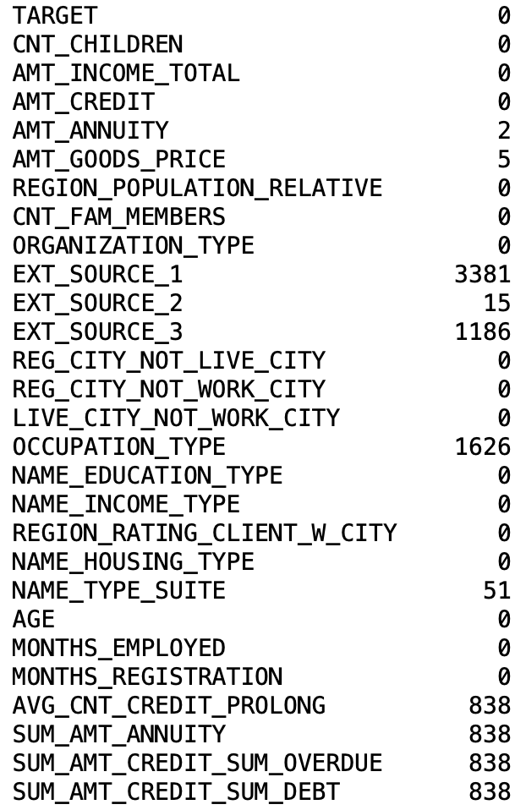
DATA PREPARATION
Missing Values in Columns
Missing Values in Rows
As we are using scorecardpy, it will create a separate bin for missing values automatically
Notes:
# bureau data modification / engineering
bur_kept = ['SK_ID_CURR', 'CREDIT_ACTIVE','AMT_CREDIT_SUM', 'AMT_CREDIT_SUM_OVERDUE', 'AMT_CREDIT_SUM_DEBT', 'CNT_CREDIT_PROLONG', 'AMT_ANNUITY',
]
df_bur_kept = df_bur[bur_kept]
df_bur_kept.head()
# Create a new df_bur_modified
df_bur_modified = pd.DataFrame()
# Add SK_ID_CURR to facilitate joins
df_bur_modified['SK_ID_CURR'] = df_bur_kept['SK_ID_CURR'].unique()
# Join groupby table for the average of CNT_CREDIT_PROLONG
df_bur_modified = df_bur_modified.merge(
pd.DataFrame(df_bur_kept.groupby('SK_ID_CURR')['CNT_CREDIT_PROLONG'].mean()),
on='SK_ID_CURR', how='left')
# Join groupby table for the sum of AMT_ANNUITY
df_bur_modified = df_bur_modified.merge(
pd.DataFrame(df_bur_kept.groupby('SK_ID_CURR')['AMT_ANNUITY'].sum()),
on='SK_ID_CURR', how='left')
# Join groupby table for the sum of AMT_CREDIT_SUM_OVERDUE
df_bur_modified = df_bur_modified.merge(
pd.DataFrame(df_bur_kept.groupby('SK_ID_CURR')['AMT_CREDIT_SUM_OVERDUE'].sum()),
on='SK_ID_CURR', how='left')
# Join groupby table for the sum of AMT_CREDIT_SUM_DEBT
df_bur_modified = df_bur_modified.merge(
pd.DataFrame(df_bur_kept.groupby('SK_ID_CURR')['AMT_CREDIT_SUM_DEBT'].sum()),
on='SK_ID_CURR', how='left')
# Join groupby table for the most frequent credit type and rename the column
# df_bur_modified = df_bur_modified.merge(
# pd.DataFrame(df_bur_kept.groupby('SK_ID_CURR')['CREDIT_TYPE'].agg(lambda x: x.value_counts().idxmax())),
# on='SK_ID_CURR', how='left')
df_bur_modified.columns = [
'SK_ID_CURR', 'AVG_CNT_CREDIT_PROLONG', 'SUM_AMT_ANNUITY',
'SUM_AMT_CREDIT_SUM_OVERDUE', 'SUM_AMT_CREDIT_SUM_DEBT',
# 'MOST_FREQUENT_CREDIT_TYPE'
]
df_bur_modified
# join bureau data on main
df = df_app_kept.merge(df_bur_modified, on = 'SK_ID_CURR', how = 'left')
df.drop('SK_ID_CURR', axis=1, inplace=True)
df

Slide 17
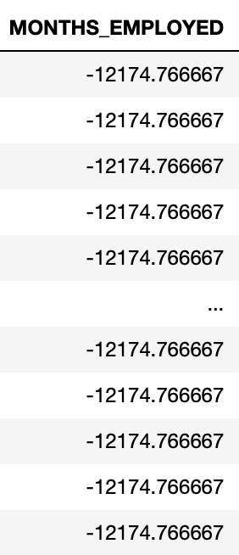
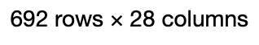
DATA PREPARATION
Rectify Invalid Observations
Remove Highly Correlated Vars
max_months_employed = - 80 * 12
df[df['MONTHS_EMPLOYED’] < max_months_employed]
Did an initial IV Screening
REG_CITY_NOT_WORK_CITY > LIVE_CITY_NOT_WORK_CITY
AMT_ANNUITY > AMT_CREDIT > AMT_GOODS_PRICE
Drop LIVE_CITY_NOT_WORK_CITY & AMT_GOODS_PRICE
df.drop(['LIVE_CITY_NOT_WORK_CITY', 'AMT_GOODS_PRICE'], axis='columns', inplace = True)
Default Value
692 rows with -12174.76667
Likely a default input for missing values
Replace it with NaN
Notes:
# bureau data modification / engineering
bur_kept = ['SK_ID_CURR', 'CREDIT_ACTIVE','AMT_CREDIT_SUM', 'AMT_CREDIT_SUM_OVERDUE', 'AMT_CREDIT_SUM_DEBT', 'CNT_CREDIT_PROLONG', 'AMT_ANNUITY',
]
df_bur_kept = df_bur[bur_kept]
df_bur_kept.head()
# Create a new df_bur_modified
df_bur_modified = pd.DataFrame()
# Add SK_ID_CURR to facilitate joins
df_bur_modified['SK_ID_CURR'] = df_bur_kept['SK_ID_CURR'].unique()
# Join groupby table for the average of CNT_CREDIT_PROLONG
df_bur_modified = df_bur_modified.merge(
pd.DataFrame(df_bur_kept.groupby('SK_ID_CURR')['CNT_CREDIT_PROLONG'].mean()),
on='SK_ID_CURR', how='left')
# Join groupby table for the sum of AMT_ANNUITY
df_bur_modified = df_bur_modified.merge(
pd.DataFrame(df_bur_kept.groupby('SK_ID_CURR')['AMT_ANNUITY'].sum()),
on='SK_ID_CURR', how='left')
# Join groupby table for the sum of AMT_CREDIT_SUM_OVERDUE
df_bur_modified = df_bur_modified.merge(
pd.DataFrame(df_bur_kept.groupby('SK_ID_CURR')['AMT_CREDIT_SUM_OVERDUE'].sum()),
on='SK_ID_CURR', how='left')
# Join groupby table for the sum of AMT_CREDIT_SUM_DEBT
df_bur_modified = df_bur_modified.merge(
pd.DataFrame(df_bur_kept.groupby('SK_ID_CURR')['AMT_CREDIT_SUM_DEBT'].sum()),
on='SK_ID_CURR', how='left')
# Join groupby table for the most frequent credit type and rename the column
# df_bur_modified = df_bur_modified.merge(
# pd.DataFrame(df_bur_kept.groupby('SK_ID_CURR')['CREDIT_TYPE'].agg(lambda x: x.value_counts().idxmax())),
# on='SK_ID_CURR', how='left')
df_bur_modified.columns = [
'SK_ID_CURR', 'AVG_CNT_CREDIT_PROLONG', 'SUM_AMT_ANNUITY',
'SUM_AMT_CREDIT_SUM_OVERDUE', 'SUM_AMT_CREDIT_SUM_DEBT',
# 'MOST_FREQUENT_CREDIT_TYPE'
]
df_bur_modified
# join bureau data on main
df = df_app_kept.merge(df_bur_modified, on = 'SK_ID_CURR', how = 'left')
df.drop('SK_ID_CURR', axis=1, inplace=True)
df

Slide 18
03
APPROACH

Slide 19
GROUPING & SCREENING (ANALYSIS)
VARIABLES | IV | PREDICTOR STRENGTH
EXT_SOURCE_3 | 0.2869 | Medium
EXT_SOURCE_2 | 0.2663 | Medium
EXT_SOURCE_1 | 0.1727 | Medium
ORGANISATION_TYPE | 0.1437 | Medium
MONTHS_EMPLOYED | 0.0842 | Weak
AMT_CREDIT | 0.0389 | Weak
AGE | 0.0380 | Weak
… | … | …
CNT_CHILDREN | 0.000145 | Not Useful
CNT_FAM_MEMBERS | 0.000145 | Not Useful
Initially have 25 variables with most variables having IV ≤ 0.1
Use business reasoning to keep weaker variables
Dropped variables deemed not useful for analysis based on IV (<0.02) & business reasoning
REG_CITY_NOT_WORK_CITY
NAME_HOUSING_TYPE
CNT_CHILDREN
REG_CITY_NOT_LIVE_CITY
CNT_FAM_MEMBERS
Kept 20 variables with mostly weak and a few medium predicting strength

Slide 20
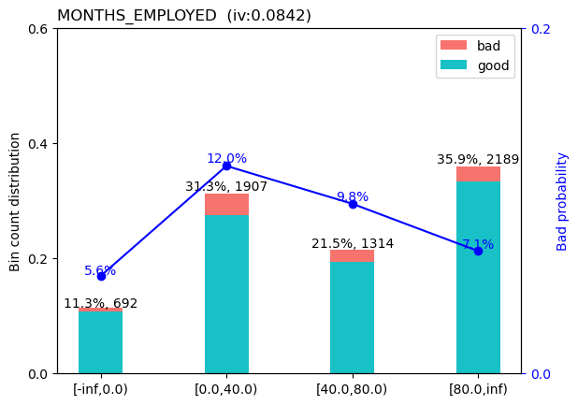
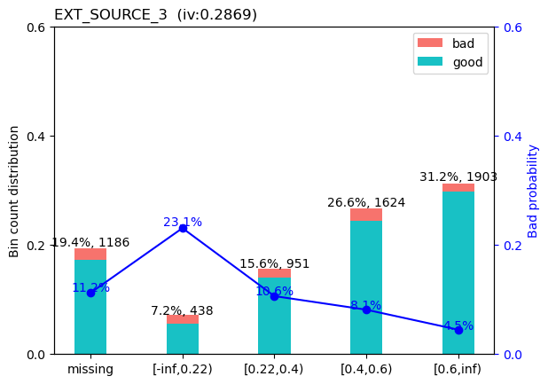
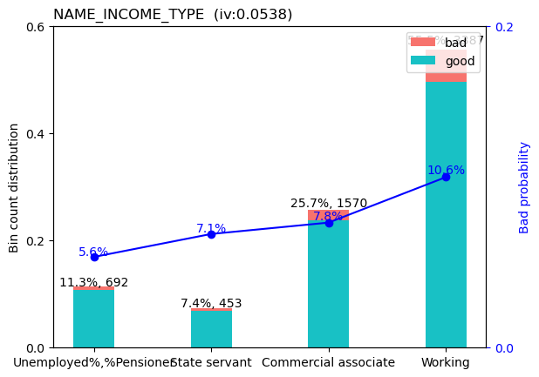
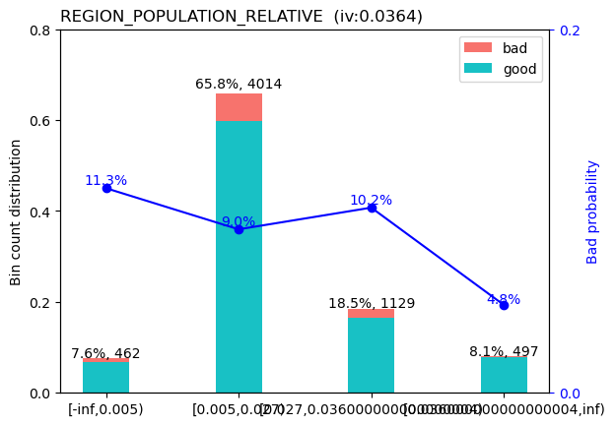
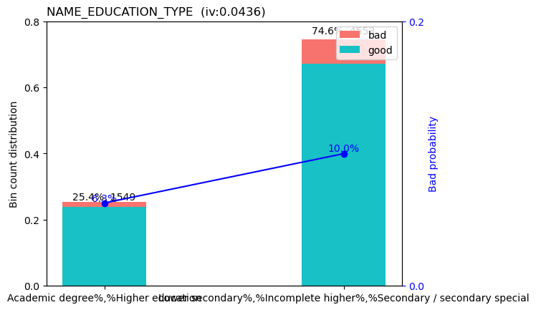
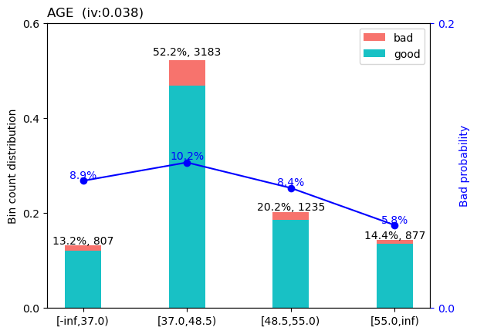
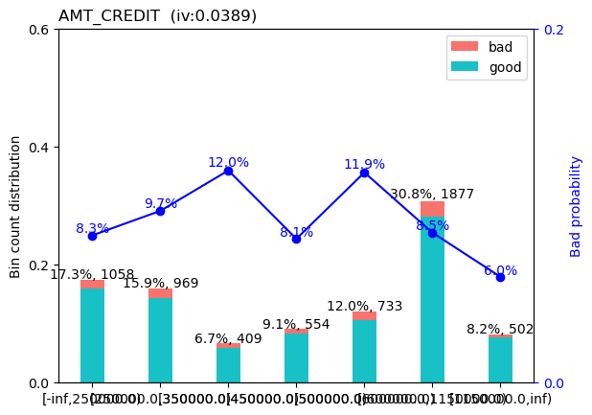
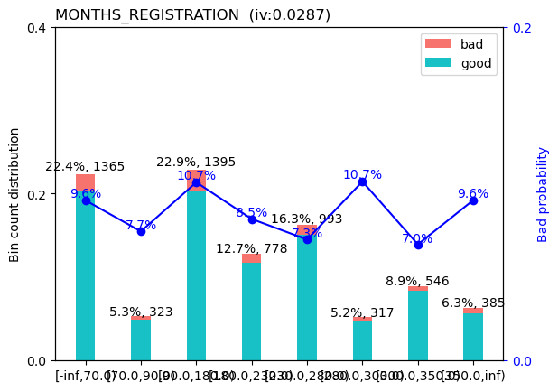
BINS PLOTTING
TESTING FOR MONOTONCITY OF REMIANING 20 VARIABLES

Slide 21
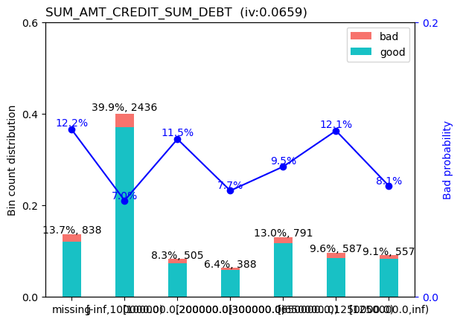
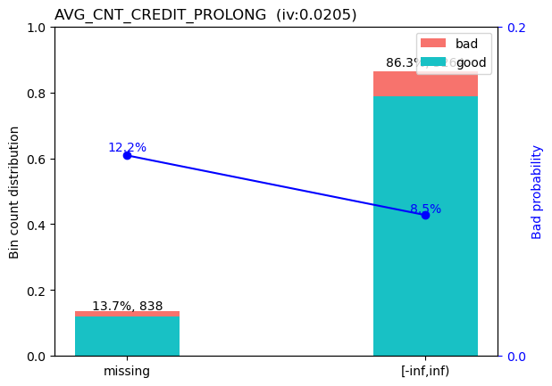
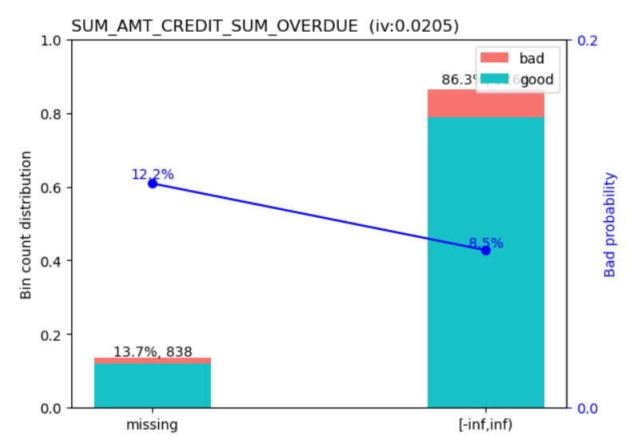
DROP VARIABLES WITH NO CLEAR TREND
'MONTHS_REGISTRATION'
‘AMT_CREDIT'
‘SUM_AMT_CREDIT_SUM_DEBT'
'AVG_CNT_CREDIT_PROLONG '
‘SUM_AMT_CREDIT_SUM_OVERDUE'

Slide 22
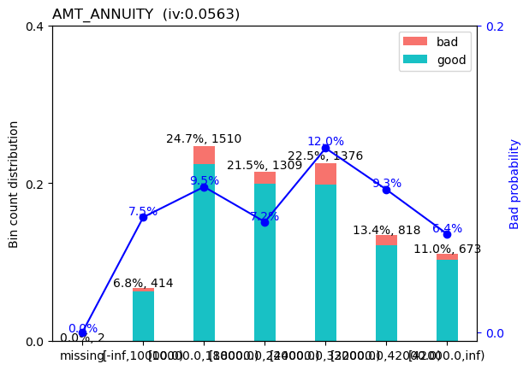
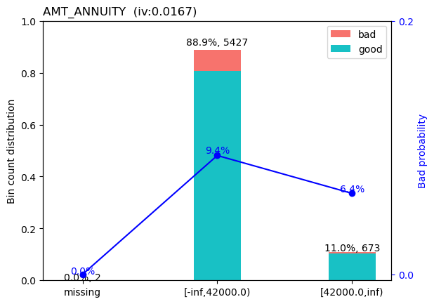
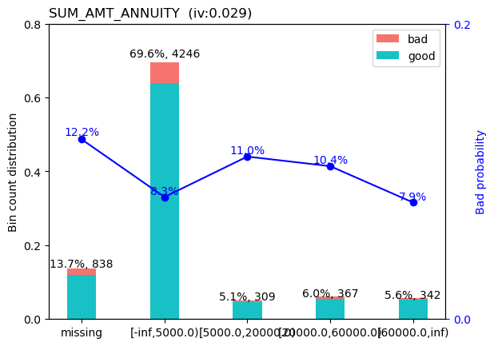
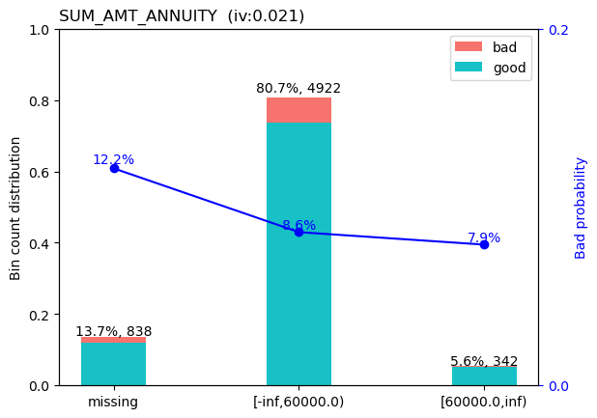
GROUPING & SCREENING (COARSE CLASSING)
Manual Adjustment for Monotonicity
As the loan annuity amount increases, there is a lower probability of default due to borrower having a better historical credit score

Slide 23
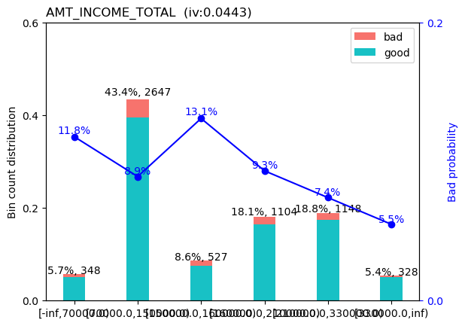
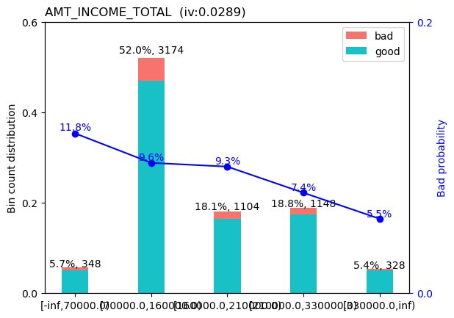
GROUPING & SCREENING (COARSE CLASSING)
Manual Adjustment for Monotonicity
As the total income of the client increases, there is a lower probability of default due to borrower being more capable to repay the loan

Slide 24
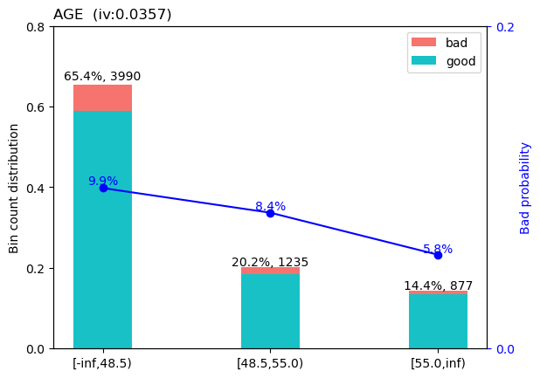
GROUPING & SCREENING (COARSE CLASSING)
Manual Adjustment for Monotonicity
As the age of the client increases, there is a lower probability of default due to the borrower having more working experience with higher income thus being more capable to repay the loan

Slide 25
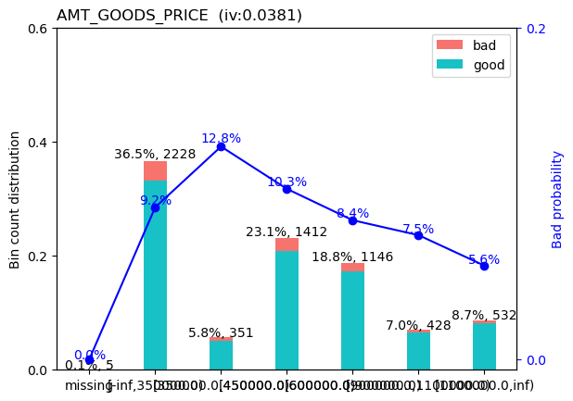
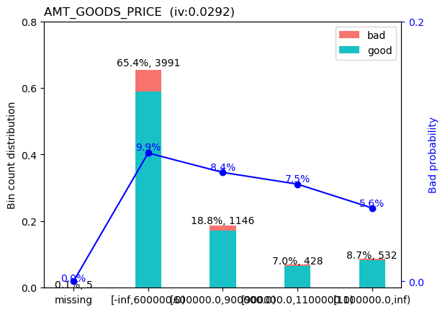
GROUPING & SCREENING (COARSE CLASSING)
Manual Adjustment for Monotonicity
As the amount of the housing loan increase, there is a lower probability of default as the interest charged / collateral is probably of higher value
Notes:
For consumer loans it is the price of the goods for which the loan is given

Slide 26
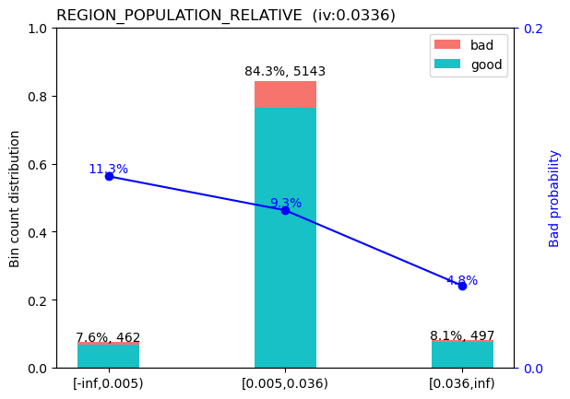
GROUPING & SCREENING (COARSE CLASSING)
Manual Adjustment for Monotonicity
Areas with high population density usually have a lower probability of default
Notes:
REGION_POPULATION_RELATIVE: Normalized population of region where client lives (higher number means the client lives in more populated region)
As the loan annuity amount increases, there is a lower probability of default due to shorter loan terms

Slide 27
GROUPING & SCREENING (COARSE CLASSING)
Final List of Variables – 14 Variables
VARIABLES | IV | PREDICTOR STRENGTH
EXT_SOURCE_3 | 0.2869 | Medium
EXT_SOURCE_2 | 0.2663 | Medium
EXT_SOURCE_1 | 0.1727 | Medium
ORGANISATION_TYPE | 0.1437 | Medium
OCCUPATION_TYPE | 0.0858 | Weak
MONTHS_EMPLOYED | 0.0842 | Weak
REGION_RATING_CLIENT_W_CITY | 0.0604 | Weak
VARIABLES | IV | PREDICTOR STRENGTH
NAME_INCOME_TYPE | 0.0538 | Weak
NAME_EDUCATION_TYPE | 0.0436 | Weak
AGE | 0.0357 | Weak
REGION_POPULATION_RELATIVE | 0.0336 | Weak
AMT_INCOME_TOTAL | 0.0289 | Weak
SUM_AMT_ANNUITY | 0.0210 | Weak
NAME_TYPE_SUITE | 0.0200 | Weak
Notes:
REGION_POPULATION_RELATIVE: Normalized population of region where client lives (higher number means the client lives in more populated region)

Slide 28
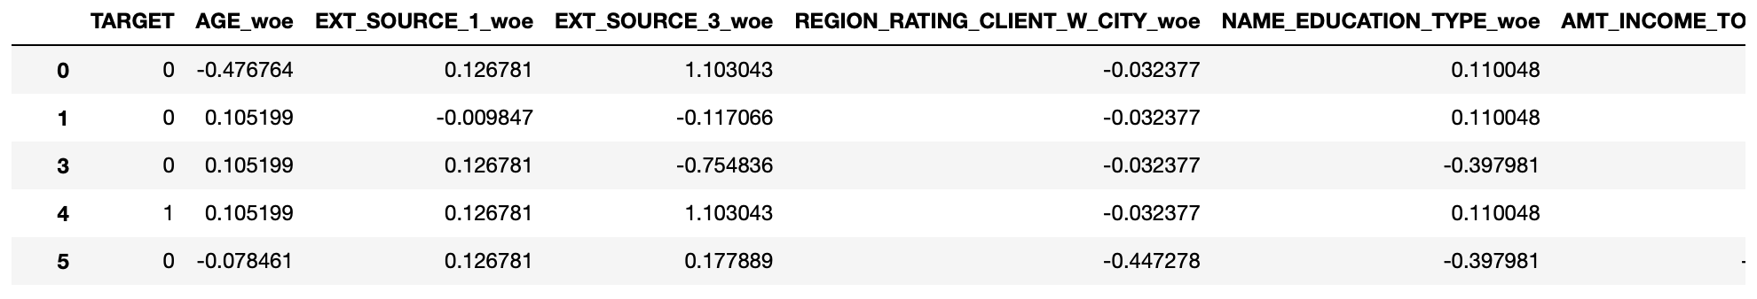
CREATE SCORECARD
Create TRAIN & TEST data (70 / 30)
train, test = sc.split_df(df, 'TARGET', ratio=0.7).values()
WOE Encoding (convert variables value into WOE values)
train_woe = sc.woebin_ply(train, bins2)
test_woe = sc.woebin_ply(test, bins2)

Slide 29
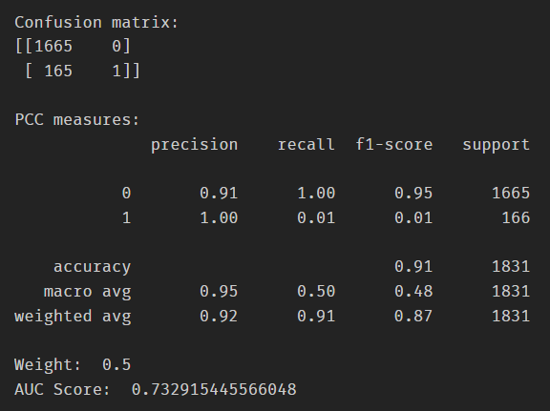
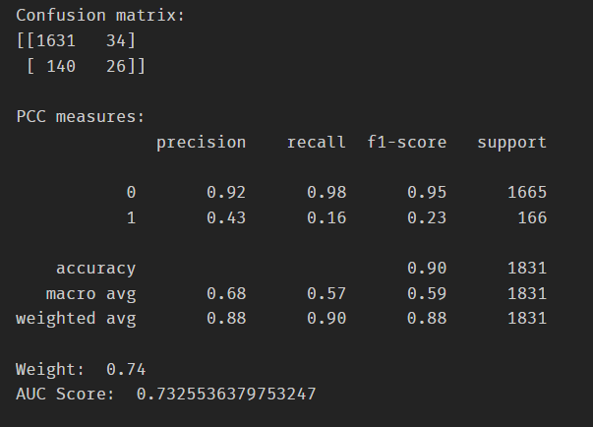
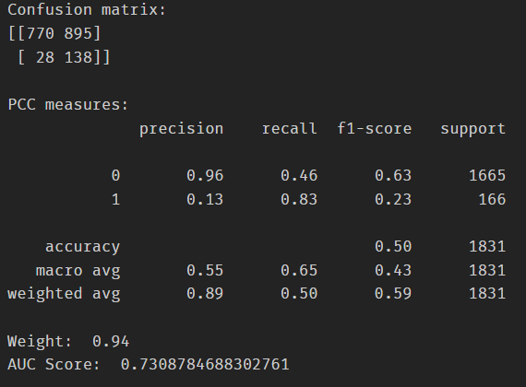
CREATE SCORECARD
Function to loop from 0.50 to 0.94 positive weight to find optimal weight
Balanced weight
Same as predicting all as no default
Higher weight for default
Predicted 16% of actual defaulters. Wrongly predicted 2% as defaulters
Very high weight for default
Predicted 83% of actual defaulters, but wrongly predicted 54% as defaulters
Notes:
for logistic regression, you use model.predict() to get y_predicted values, then apply confusion matrix and classification report

Slide 30

CREATE SCORECARD
Logistic Regression
optimal_weight = 0.88
lr = LogisticRegression(class_weight={0: (1-optimal_weight), 1: optimal_weight})
lr.fit(X_train, y_train)
Scorecard Generation
card = sc.scorecard(bins2, lr, X_train.columns, points0=600, odds0=1/50, pdo=20, basepoints_eq0=True)
pprint.pprint(card)
Notes:
for logistic regression, you use model.predict() to get y_predicted values, then apply confusion matrix and classification report

Slide 31
Analysis & Tuning
Confusion Matrix
Actual\Predicted | 0 (No default) | 1 (default)
0 (No default) | 1323 | 342 | 1665
1 (default) | 78 | 88 | 166
 | 1401 | 43 | 1831
Evaluation Metrics
GOODS / BADS | PRECISION | RECALL | F1-SCORE | Accuracy
0 (No default) | 0.94 | 0.79 | 0.86 | 0.77
1 (default) | 0.2 | 0.53 | 0.30
Macro avg | 0.57 | 0.66 | 0.58
Weighted avg | 0.88 | 0.77 | 0.81
Predicted 53% of defaulters correctly,
Wrongly predicted 21% as defaulters

Slide 32


Analysis & Tuning

Slide 33
04
WALKTHROUGH

Slide 34
EXAMPLE OF APPLICANT (SCORECARD)
Characteristics | Attribute | Score Points
AGE | < 48.5 | 36.0
 | 48.5 – 55.0 | 35.0
 | > 55.0 | 32.0
EXT_SOURCE_1 | Missing | 27.0
EXT_SOURCE_1 | < 0.38 | 25.0
 | 0.38 – 0.54 | 36.0
 | 0.54 – 0.62 | 44.0
 | > 0.62 | 55.0
REGION_POPULATION_RELATIVE | < 0.005 | 34.0
 | 0.005 – 0.036 | 35.0
 | > 0.036 | 39.0
MONTHS_EMPLOYED | Missing | 41.0
MONTHS_EMPLOYED | < 70.0 | 33.0
 | 70.0 – 220.0 | 37.0
 | > 220.0 | 41.0
Characteristics | Attribute | Score Points
NAME_TYPE_SUITE | Missing | 38.0
 | Group of people , Other_A, Other_B, Family | 42.0
 | Spouse, partner, Children, Unaccompanied | 35.0
SUM_AMT_ANNUITY | Missing | 34.0
 | < 60,000 | 36.0
 | > 60,000 | 36.0
ORGANIZATION_TYPE | missing | 38.0
 | HR staff , IT staff, Private service staff | 44.0
 | Core staff, High skill tech staff, Managers | 37.0
 | Medicine staff, Waiters/ barmen staff, Cleaning | 33.0
 | Laborers, Secretaries, Cooking staff, Low-s… | 31.0

Slide 35
EXAMPLE OF APPLICANT (SCORECARD)
Characteristics | Attribute | Score Points
EXT_SOURCE_2 | missing | 27.0
 | < 0.18 | 16.0
 | 0.18 - 0.52 | 29.0
 | 0.52 - 0.64 | 38.0
 | 0.64 - 0.7000000000000001 | 45.0
 | > 0.7000000000000001 | 54.0
NAME_INCOME_TYPE | Unemployed, Pensioner | 35.0
EXT_SOURCE_1 | State servant | 35.0
 | Commercial associate | 35.0
 | Working | 35.0
EXT_SOURCE_3 | missing | 29.0
 | < 0.22 | 8.0
 | 0.22 - 0.4 | 31.0
 | 0.4 - 0.6 | 38.0
MONTHS_EMPLOYED | > 0.6 | 54.0
Characteristics | Attribute | Score Points
REGION_ RATING_ CLIENT_W_ CITY | < 2.0 | 42.0
 | 2.0 - 3.0 | 36.0
 | > 3.0 | 29.0
NAME_ EDUCATION_ TYPE | Academic degree, Higher education | 41.0
 | Lower secondary, Incomplete higher, Secondary, … | 34.0
AMT_INCOME_TOTAL | < 70000.0 | 38.0
 | 70000.0 - 160000.0 | 36.0
 | 160000.0 - 210000.0 | 36.0
 | 210000.0 - 330000.0 | 34.0
 | > 330000.0 | 32.0
OCCUPATION_TYPE | missing | 38.0
 | HR staff, IT staff, Private service staff | 44.0
 | Core staff, High skill tech staff, Managers | 37.0
 | Medicine staff, Waiters/barmen staff, Cleani... | 33.0
 | Laborers, Secretaries, Cooking staff, Low-s… | 31.0

Slide 36
EXAMPLE OF APPLICANT (CHARACTERISTICS)
Variable | Applicant Value
Age | 37.5
EXT_SOURCE_1 | NaN
REGION_POPULATION_RELATIVE | 0.025164
MONTHS_EMPLOYED | NaN
NAME_TYPE_SUITE | Family
SUM_AMT_ANNUITY | 12163.500
ORGANIZATION_TYPE | XNA
EXT_SOURCE_2 | 0.293988
NAME_INCOME_TYPE | Pensioner
EXT_SOURCE_3 | 0.115387
REGION_RATING_CLIENT_W_CITY | 2
NAME_EDUCATION_TYPE | Secondary/ Secondary Special
AMT_INCOME_TOTAL | 112500.0
OCCUPATION_TYPE | NaN

Slide 37
EXAMPLE OF APPLICANT (SCORECARD RESULTS)
Variable | Applicant Value | Points
Age | 37.5 | 36
EXT_SOURCE_1 | NaN | 33
REGION_POPULATION_RELATIVE | 0.025164 | 35
MONTHS_EMPLOYED | NaN | 41
NAME_TYPE_SUITE | Family | 42
SUM_AMT_ANNUITY | 12163.500 | 36
ORGANIZATION_TYPE | XNA | 42
EXT_SOURCE_2 | 0.293988 | 29
NAME_INCOME_TYPE | Pensioner | 35
EXT_SOURCE_3 | 0.115387 | 8
REGION_RATING_CLIENT_W_CITY | 2 | 36
NAME_EDUCATION_TYPE | Secondary/ Secondary Special | 34
AMT_INCOME_TOTAL | 112500.0 | 36
OCCUPATION_TYPE | NaN | 38
Score = 481
With TargetScore 600, Odds 1:50, pdo 20
This applicant will be predicted as a defaulter. Not approved.
Lowering Odds to 1:3 (25% not approved)
Required Score = 520
Still not approved.

Slide 38
05
LIMITATIONS & CONCLUSION

Slide 39
LIMITATIONS
Upon sub-setting the data according to our target group, the correlation matrix indicated that most variables do not share a strong correlation with the Target variable
The IV values of most variables used in the model were within the 'weak predictive range'
Our choice of subset may not be entirely representative of singles applying for HDB
Unsure of recency of data
It is necessary to check how relevant the sample is compared to current population using PSI metrics
Acknowledge that the strict conditions for our business opportunity may be too restrictive, resulting in poor WOE for the remaining variables
Several housing related variables were immediately disqualified on the assumption that the borrower does not own a house, which limits our choices
Spent more time on feature engineering to find hidden features that result in higher IV

Slide 40
Conclusion
The best model we generated has an ROC AUC of 0.73, recall of 0.53, and accuracy of 0.77
We prioritised maximising recall to identify as many defaulters as possible, as opposed to precision which aims to reduce false positives
This may be adjusted for different businesses according to the business context
Several of the earlier scorecards that we generated were not nearly as good as what we have now due to
Insufficient relevant variables
Accidently including correlated variables

